Slide 1



Parametrised Quantum Circuits
for Quantum State Preparation
David Amorim Supervisor: Prof Sarah Croke
Quantum Theory Group, University of Glasgow
1. Background: Quantum Computing
In classical computing the base unit of information is the bit, which can take on the value 0 or 1.
Quantum computers process qubits, which can exist in a superposition of states $|0⟩$ and $|1⟩$. This gives quantum computers a quantum advantage over classical computers when solving some problems.
Quantum algorithms are often represented as so-called quantum circuits, where qubits are processed via quantum gates.
2. Challenge: the NISQ Regime
The current state of quantum computing is referred to as ‘noisy intermediate scale quantum’ (NISQ) computing: available prototype quantum computers are limited in their number of qubits and gates.
Parametrised Quantum Circuits (PQCs) are an important tool to develop quantum algorithm that use as few qubits and gates as possible. PQCs are trained via machine learning to optimise weights in gate-efficient template circuits and are crucial in the NISQ regime.
3. Aim: Quantum State Preparation
Quantum state preparation is the process of loading data onto a quantum computer. The aim of this project was to implement this as efficiently as possible using parametrised quantum circuits.

Slide 2
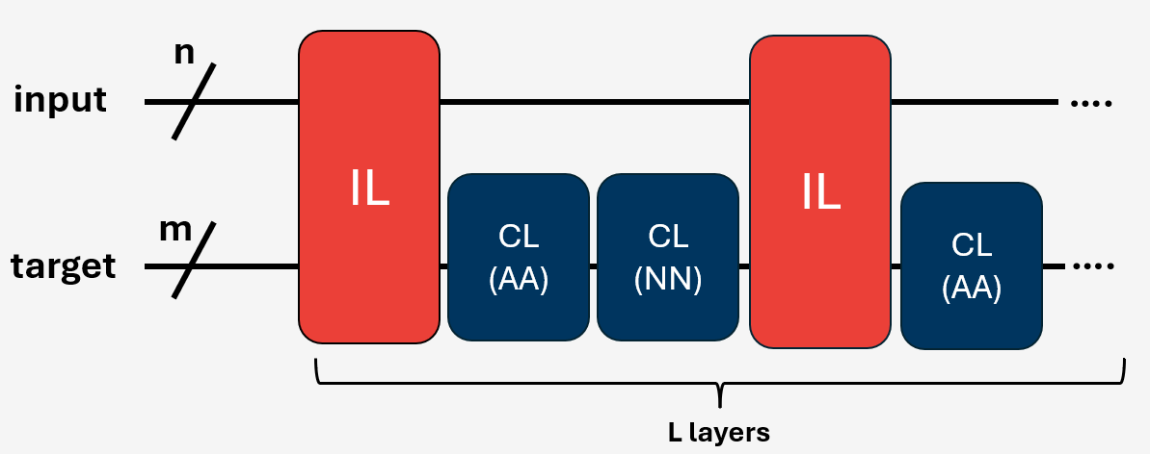
4. Algorithm: Amplitude Encoding
In [1] an algorithm for quantum state preparation is presented, based on so-called amplitude encoding.
This involves preparing an amplitude distribution as well as evaluating a phase function. This project implemented both of these steps using parametrised quantum circuits (PQCs).
5. Approach: a QCNN
A quantum convolutional neural network (QCNN) was used to implement amplitude encoding more efficiently. A QCNN is a PQC involving multiple layers.
Convolutional layers (CLs) involve multi-qubit entanglement gates while input layers (ILs) involve controlled single-qubit rotation gates. For increased network connectivity, two types of CLs were implemented (all-to-all and neighbour-to-neighbour). The QCNN used alternating CLs and ILs. This is shown in Figure 1.
To perform phase function evaluation, the QCNN must be applied to two qubit registers (the input register and the target register). Preparing the amplitude distribution is simpler, requiring only one register and no ILs.
6. Training: Designing a Loss Function
Training the QCNN via machine learning requires a loss function that captures the ‘distance’ between output and target state. A custom loss function, sign-adjusted mismatch (SAM), was designed for the problem at hand.
Figure 1: Schematic of the QCNN structure. The network involves alternating input layers (ILs) and convolutional layers (CLs) of all-to-all (AA) or neighbour-to-neighbour (NN) type. The layers are applied to the n-qubit input register and the m-qubit target register.

Slide 3
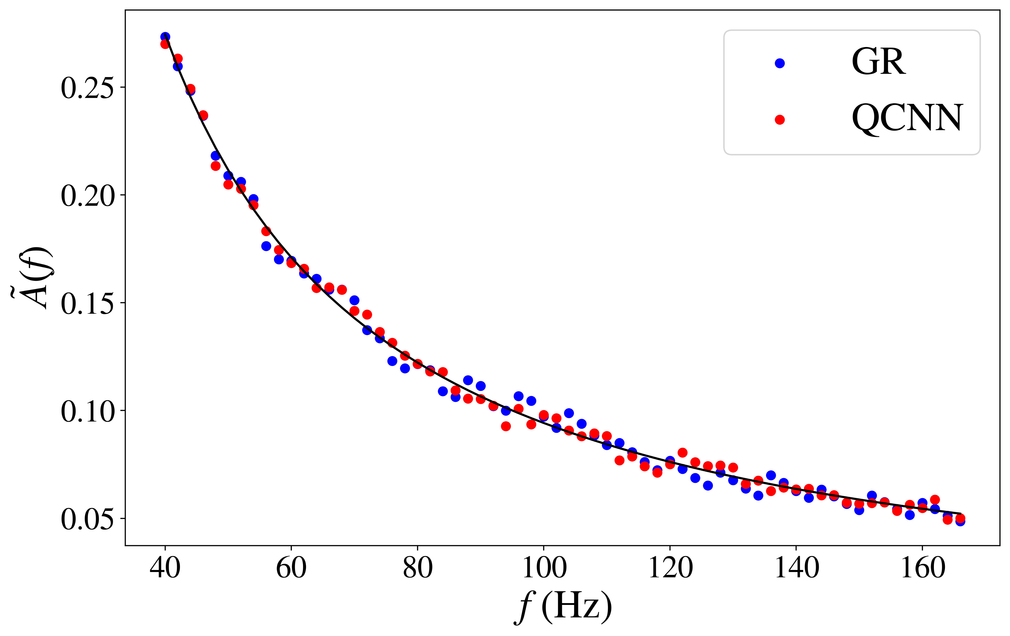
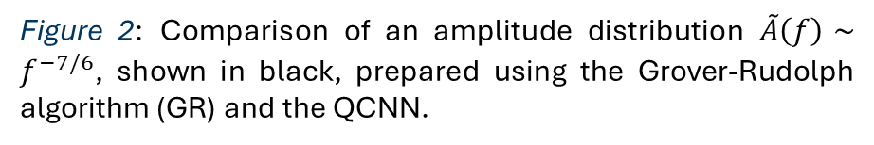
7. Results
As shown in Figure 2, the QCNN could prepare an amplitude distribution with the same accuracy as the Grover-Rudolph algorithm used in [1]. However, the latter requires 28 qubits and 23,796 quantum gates to achieve this while the QCNN only used 6 qubits and 72 gates. Thus, the QCNN could prepare the amplitude with a much higher efficiency.
The phase component of the state preparation algorithm could only be implemented with moderate success: the QCNN was able to evaluate simple phase functions with relatively high accuracy but failed for more sophisticated cases. This is partly due to phases not being directly accounted for during the parameter optimisation process.
Figure 2: Comparison of an amplitude distribution $\tilde{A}\left(f\right)∼f^{−7/6}$, shown in black, prepared using the Grover-Rudolph algorithm (GR) and the QCNN.
8. Software: pqcprep
This project resulted in the Python package pqcprep [2] which provides tools for generating and training parametrised quantum circuits for a range of applications.
9. Conclusion
It was shown that parametrised quantum circuits can be used for efficient quantum state preparation. The achieved accuracy could be improved by modifying the algorithm to be less reliant on function evaluation.
References
[1] F. Hayes et al. (2023), “Quantum state preparation of gravitational waves,” Pre-print, arXiv: 2306.11073
[2] Available via the Python Package Index (PyPI) at https://pypi.org/project/pqcprep/
Acknowledgements
Thank you to Sarah Croke and the Trust for making this project possible.

